Slide 1


SIMATS ENGINEERING
Saveetha Institute of Medical and Technical S
Chennai-602105.
AI Water Based Demand Forecasting and Resource Optimization System
CSA1707 - ARTIFICIAL INTELLIGENCE
Presented By:
R Venkatesh (192212267)
G Hema Chowdary(192473014)
P Kalyani (192472199)
Supervised By:
Dr. R.Veeramani

Slide 2


ABSTRACT
AI predicts water demand using past consumption, weather, and demographic data.
Optimizes water distribution and pumping schedules across different zones.
Detects abnormal usage and potential water leakages in near real time.
Interactive dashboard helps operators monitor demand and make faster decisions.
Goal: Reduce water loss, improve supply reliability, and use resources efficiently.

Slide 3
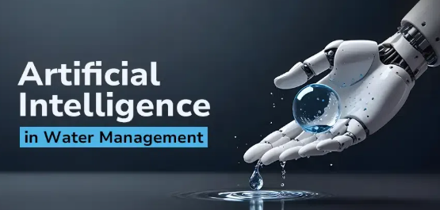
INTRODUCTION
Water is a limited resource that requires efficient management due to increasing demand.
Traditional water management methods are inefficient and cannot accurately predict future.
Artificial Intelligence analyzes large amounts of water-related data such as usage, weather areas.
The system predicts future water demand to prevent shortages and overuse.

Slide 4
PROBLEM STATEMENT
Unpredictable water demand leads to water shortages in some areas and wastage in others.
Lack of accurate forecasting methods makes it difficult to plan and manage water resources effectively.
Rapid population growth and urbanization increase pressure on existing water supply systems.
Climate change and irregular rainfall patterns affect water availability and storage planning.
Inefficient water distribution systems result in water loss, higher costs, and unsustainable usage.

Slide 5
OBJECTIVES
To design a machine learning model that forecasts short-term and long-term water demand at a zone level.
To develop a resource optimization module that plans efficient distribution and pump scheduling based on forecasted demand.
To detect anomalies and possible leakages through consumption pattern analysis.
To build an interactive dashboard that visualizes forecasts, resource allocation, and alerts for utility operators.
To reduce non-revenue water loss and improve the overall efficiency and reliability of the water supply system.

Slide 6
Existing System
Basic Forecasting: Uses historical averages and simple statistical methods.
Monitoring Only: SCADA tracks flow and pressure but lacks prediction.
Manual Decisions: Pumping and distribution depend on operator experience.
Limited Detection: Leaks and anomalies are mainly found through inspections or complaints.
Key Gap: No integrated AI-based prediction, optimization, and anomaly detection.

Slide 7
Existing System Drawback
Low forecasting accuracy, since weather, seasonal trends, and event-based demand spikes are not accounted for.
No automated optimization of pump scheduling or distribution planning.
Delayed leak and anomaly detection leads to significant water loss before issues are identified.
Heavy reliance on manual effort, which is time-consuming and prone to human error.
Absence of a centralized dashboard for real-time monitoring and decision support.

Slide 8
PRAPOSED SYSTEM
AI-Based Demand Prediction – Uses historical water usage, weather, and seasonal data to predict future water demand.
Real-Time Data Monitoring – Monitors water consumption, tank levels, rainfall, and available water resources.
Smart Resource Allocation – Automatically suggests how much water should be supplied to different areas based on predicted demand.
Water Shortage & Leakage Alerts – Detects unusual consumption and warns about possible shortages or wastage.
Efficient & Sustainable Management – Reduces water wastage, improves distribution, and supports better long-term water resource planning.

Slide 9
LITERATURE REVIEW
YEAR | PAPER NAME | MERITS | DEMERITS
2022 | AI-Based Water Demand Forecasting Using Machine Learning Models | High prediction accuracy using historical data | Performance depends on data quality
2023 | Smart Water Resource Management Using AI and IoT | Real-time monitoring reduces water wastage | High implementation cost
2023 | Deep Learning Approach for Urban Water Demand Prediction | Handles complex patterns and large data | Requires high computational power
2024 | AI-Driven Water Distribution Optimization System | Improves efficiency and reduces water loss | Limited scalability in rural areas
2025 | Sustainable Water Management Using AI Forecasting Techniques | Supports long-term planning and sustainability | Needs continuous data updates

Slide 10
DATASETS USED
Historical water consumption data from domestic, agricultural, and industrial sectors to analyze usage patterns and seasonal trends.
Weather and climate data such as rainfall, temperature, humidity, and drought conditions affecting water demand and availability.
Population growth and urban development data used to estimate future water requirements.
Reservoir, river, and groundwater level data to assess available water resources and plan distribution.
Agricultural irrigation and industrial water usage data to optimize allocation and reduce wastage.

Slide 11
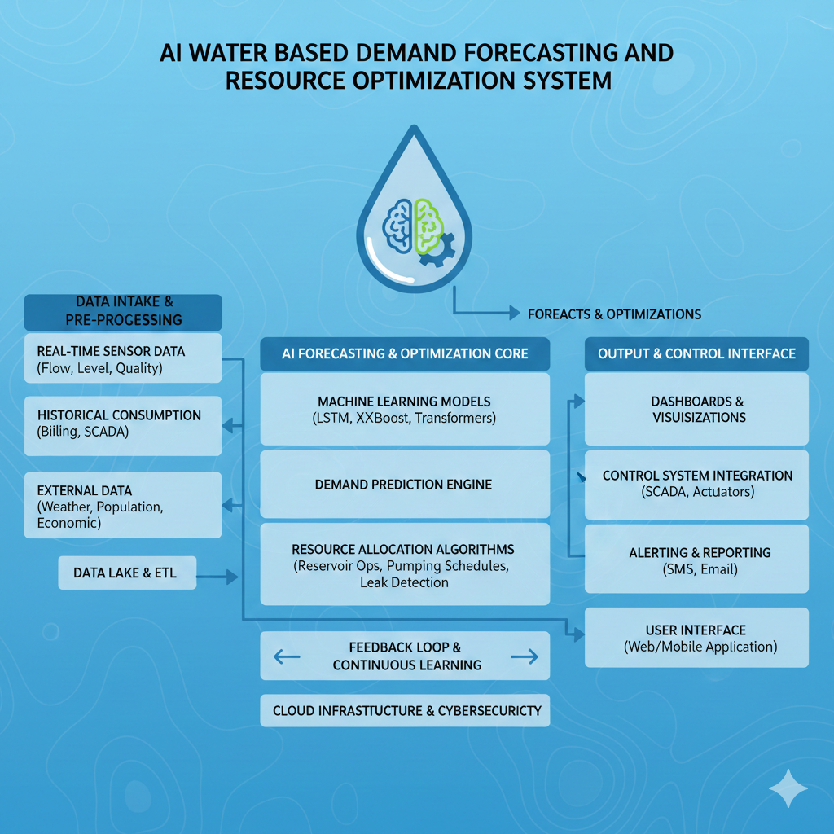
ARCHITECTURE DIAGRAM

Slide 12
Module 1: Data Acquisition & Preprocessing
Collects water usage data from households, industries, agriculture, tanks etc.
Integrates weather data such as rainfall, temperature, and humidity to understand demand variations.
Cleans and validates data by handling missing values, duplicate records, and abnormal readings.
Creates useful features such as daily consumption, peak-hour usage, seasonal demand, and storage levels.
Generates an AI-ready dataset by normalizing and organizing all information for accurate prediction.

Slide 13
Module 2: AI-Based Water Demand Forecasting & Resource Optimization
Predicts future water demand using machine-learning models based on historical and environmental patterns.
Identifies peak-demand periods and anticipates possible shortages before they occur.
Optimizes water allocation by matching available resources with the predicted requirement of each area.
Performs what-if analysis to estimate the impact of drought, rainfall changes, population growth, or increased consumption.
Recommends an efficient supply plan that minimizes wastage while maintaining sufficient water availability

Slide 14
Module 3: Monitoring, Visualization & Control
Provides a real-time dashboard showing water demand, consumption, storage, and predicted requirements.
Displays area-wise water status to identify high-demand and low-supply regions quickly.
Generates intelligent alerts for shortages, abnormal consumption, possible leakage, and critical storage levels.
Tracks system performance using indicators such as forecast accuracy, water saved, and resource utilization.
Supports decision-making and control by allowing authorities to monitor conditions and adjust water distribution based on AI recommendations.

Slide 15
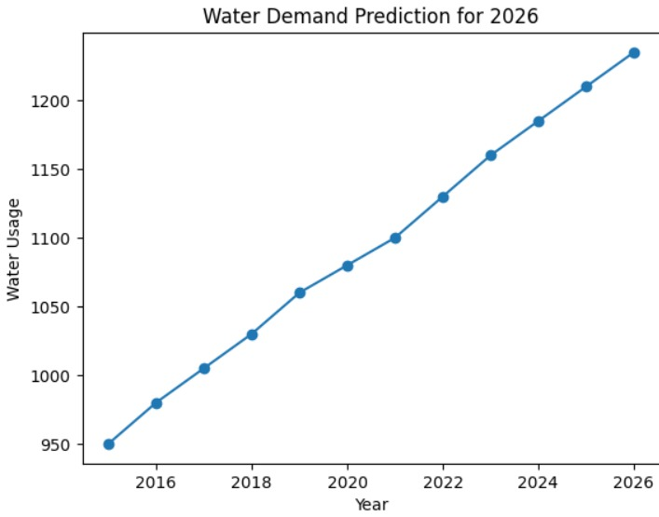
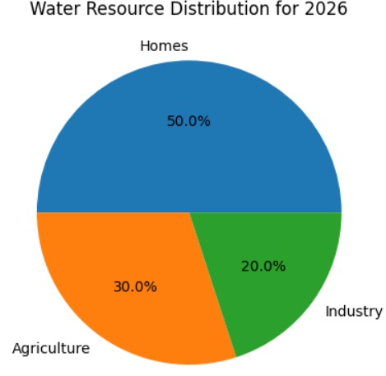


RESULT & OUTPUT

Slide 16
Future Scope
Integration with IoT and Smart Sensors Future versions can integrate real-time IoT sensors for water level, flow rate, pressure, and quality to improve prediction accuracy and instant decision-making.
Advanced Deep Learning Models Implementation of LSTM, GRU, Transformer, and hybrid deep learning models can enhance long-term and seasonal water demand forecasting.
Integration with Renewable Energy Systems Coordinating water pumping and treatment operations with renewable energy availability to reduce operational costs.
AI-Driven Water Pricing and Demand Management Dynamic pricing strategies based on predicted demand to encourage efficient water usage.

Slide 17
CONCLUSION
The AI-based system effectively analyzes large volumes of data to accurately predict future water demand across different regions.
Intelligent resource optimization helps reduce water wastage while ensuring sufficient supply for all sectors.
Continuous monitoring and real-time control improve overall efficiency and reliability of water management systems.
The system supports informed decision-making by providing clear insights and actionable forecasts to authorities.
Overall, the solution promotes sustainable, efficient, and long-term water resource management.

Slide 18
REFERENCES
Adamowski, J., & Karapataki, C. (2024). Comparison of multivariate regression and artificial neural networks for peak urban water-demand forecasting. Journal of Hydrologic Engineering, 15(10), 729–743.
Zhang, G., Patuwo, B. E., & Hu, M. Y. (2022). Forecasting with artificial neural networks: The state of the art. International Journal of Forecasting, 14(1), 35–62.
Donkor, E. A., Mazzuchi, T. A., Soyer, R., & Roberson, J. A. (2023). Urban water demand forecasting: Review of methods and models. Journal of Water Resources Planning and Management, 140(2), 146–159.
Giustolisi, O., & Savic, D. A. (2025). A symbolic data-driven technique based on evolutionary polynomial regression. Journal of Hydroinformatics, 8(3), 207–222..

Slide 19
Thank you

